Slide 1
Unit 3A
Human Form & Function
Cells, metabolism & regulation
Regulation of fluid composition

Slide 2

Study Guide
Read:
Our Human Species (3rd edtn)
Chapter 13
Complete:
Human Biological Science Workbook
Topic 5 – Regulation of Fluid Composition

Slide 3
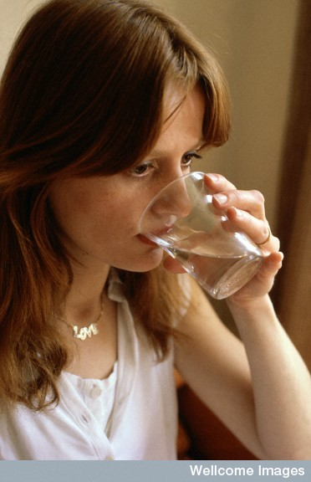
Fluid balance
Water in
  Food 1000 ml
  Fluids 1200 ml
  Metabolic water
  (from respiration) 300 ml
  TOTAL 2500 ml
Anthea Sieveking, Wellcome Images

Slide 4
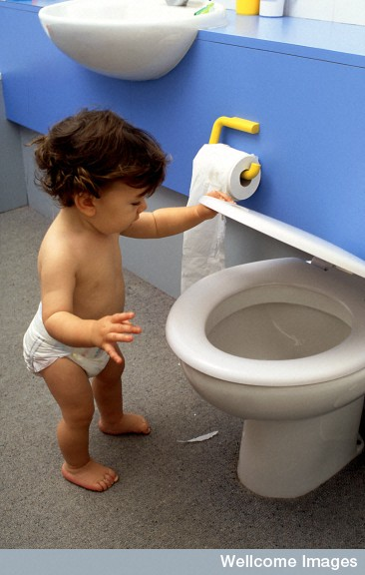
Water out
  Urine 1200 ml
  Sweating 750 ml
  Lungs 400 ml
  Faeces 150 ml
  TOTAL 2500 ml
Anthea Sieveking, Wellcome Images

Slide 5
Water in the body
Approximate fluid make-up of a 70 kg person
Intracellular fluid 21 L
Extracellular fluids
  Interstitial (tissue) fluid 13.8 L
  Blood plasma 3.0 L
  Other 0.7 L
17.5 L
TOTAL 38.5 L

Slide 6
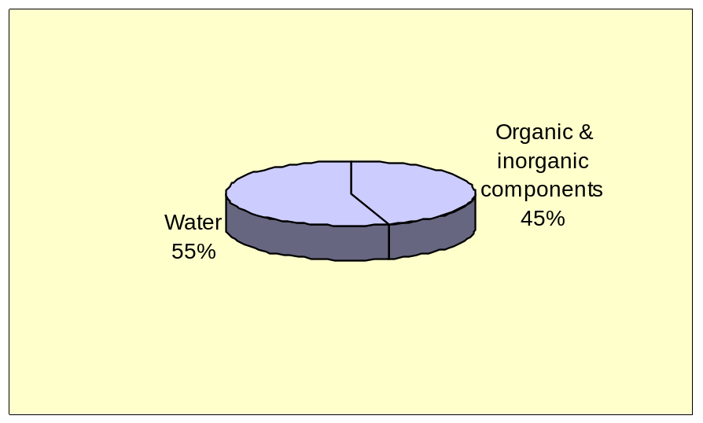
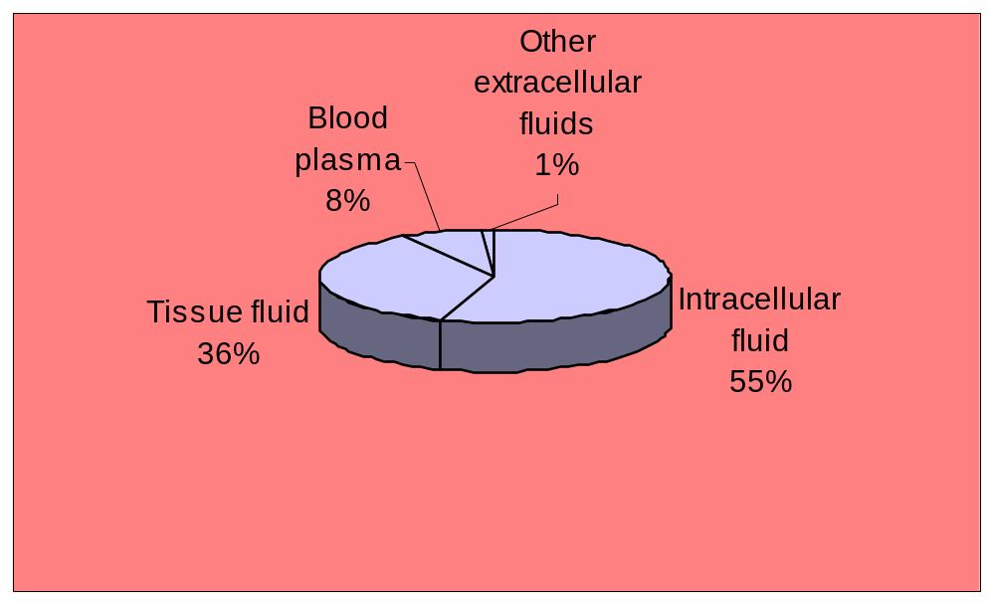
Body fluids

Slide 7
Fluid circulation
Substances enter and leave the bloodstream via the permeable capillaries.
At the arterial end of a capillary there is a mass flow of plasma and nutrients from the bloodstream into the tissue fluid.
This occurs because the blood pressure is greater than the osmotic pressure (working in the opposite direction).

Slide 8
As the blood is forced through the capillary the blood pressure drops.
At the venous end of a capillary there is a mass flow of tissue fluid and wastes from the tissues into the bloodstream.
This occurs because the blood pressure is now less than the osmotic pressure.

Slide 9
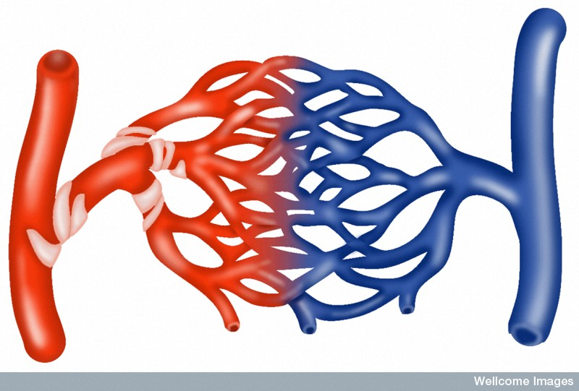
Fluid circulation
Venule
Nutrients
Arteriole
Wastes
Capillary bed
BP
BP
Osmosis
Osmosis
Tissue fluid
Tissue fluid

Slide 10
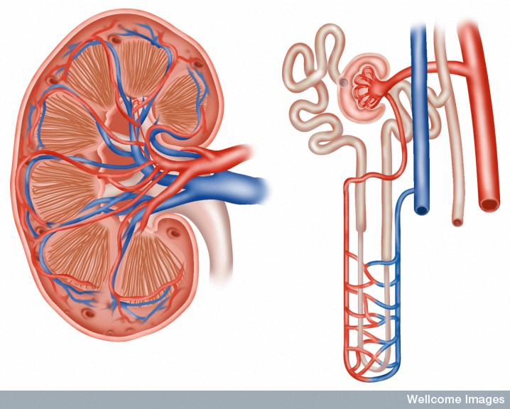
Structure of the kidney
Proximal convolute tubule
Distal convolute tubule
Capsule
Cortex
Renal corpuscle
Medulla
Pyramid
Renal artery
Collecting duct
Renal vein
Loop of Henle
Pelvis of ureter
Peritubular capillaries
Ureter
LS of KIDNEY
A NEPHRON

Slide 11
Kidneys functions
Fluid balance
Salt balance
Removal of wastes (especially urea)
pH balance
Interdependent

Slide 12
Fluid balance
The kidneys play an important role in the homeostatic regulation of body fluids (both the amount and the composition).
If we become dehydrated the kidneys can increase the reabsorption of water from the filtrate, whilst also increasing the secretion of salt.
If our tissue fluids are too dilute the opposite occurs.

Slide 13
Water reabsorption
60-70 % of water reabsorption occurs in the proximal convolute tubule*.
The remaining 30-40 % is selectively reabsorbed in the loop of Henle, distal convolute tubule and collecting duct, depending on our state of dehydration.
*How much water is reabsorbed at both stages depends on our state of dehydration i.e. less water is reabsorbed if our tissue fluid is dilute; more if we are dehydrated.

Slide 14
Urine formation
There are three stages in urine formation:
Filtration (in the renal corpuscle)
Selective reabsorption (mainly in the proximal convolute tubule – some water and salts are reabsorbed in the loop of Henle and the distal convolute tubule)
Tubular secretion (in the proximal convolute tubule and the distal convolute tubule)

Slide 15
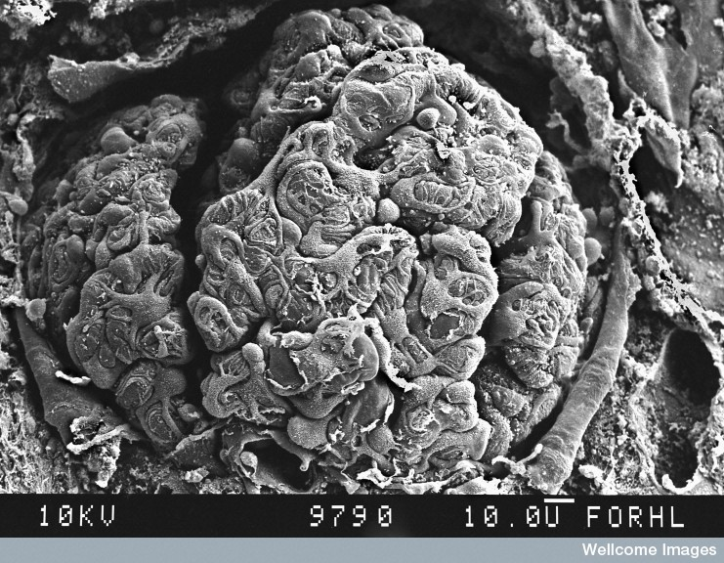
EM of a glomerulus
D Gregory & D Marshall, Wellcome Images

Slide 16
Filtration
Process | Structure | Substance | Active/passive
Filtration | Renal corpuscle | Filtrate
 |  | Water Urea, Glucose, Amino acids, Vitamins, Salts (mainly sodium & chlorine) | Passive (mass flow) Passive

Slide 17
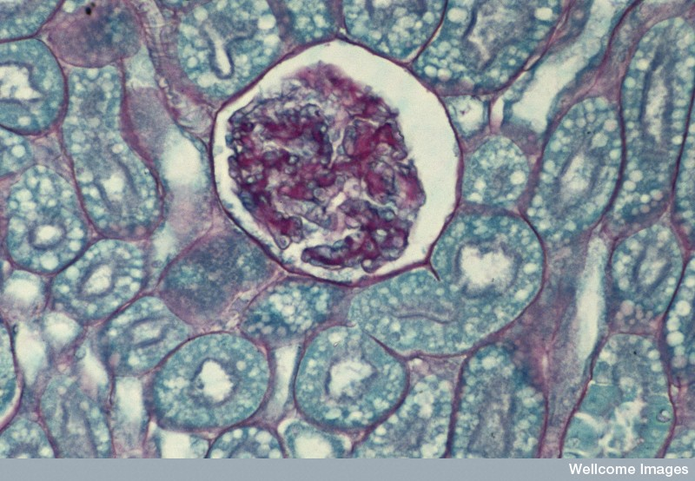
Section showing Bowman's capsule, glomerulus and tubules
Bowman's capsule
Glomerulus
Tubule
Wellcome Photo Library

Slide 18
Selective reabsorption
Process | Structure | Substance | Active/passive
Reabsorption | PCT | Water (60-70%) Salts (60-70%) Glucose (100%) Amino acids (100%) Vitamins (100%) | Passive (osmosis) All active
 | Loop of Henle | Water (25%) Na⁺/Cl⁻ (25%) | Passive (osmosis) Active
 | DCT | Water (5%) Na⁺/Cl⁻ (5%) | Passive (osmosis) Active
 | Collecting duct | Water (5%) | Passive (osmosis)

Slide 19
Tubular secretion
Process | Structure | Substance | Active/passive
Tubular secretion | PCT & DCT | H⁺ NH₄⁺ (ammonium) Creatinine Toxins Drugs Neurotransmitters | Active

Slide 20
Selective water reabsorption
The second stage of water reabsorption is important if we become dehydrated.
It can be divided into two phases (though both are interdependent).
The first phase involves the reabsorption of salt under the influence of the hormone aldosterone.
2. The second phase involves the reabsorption of water under the influence of the antidiuretic hormone (ADH).

Slide 21
Reabsorption of salt under the influence of aldosterone
Stimulus
Decreased blood volume
→ reduced blood pressure
Receptor
Baroreceptors in Renal artery

Slide 22
Transmission
Several chemical messengers ending with release of aldosterone from
the adrenal cortex
Effector
Sodium pumps in DCT and loop of Henle
Response
Sodium reabsorbed increasing ion concentration in interstitial fluid
(creates osmotic gradient)

Slide 23
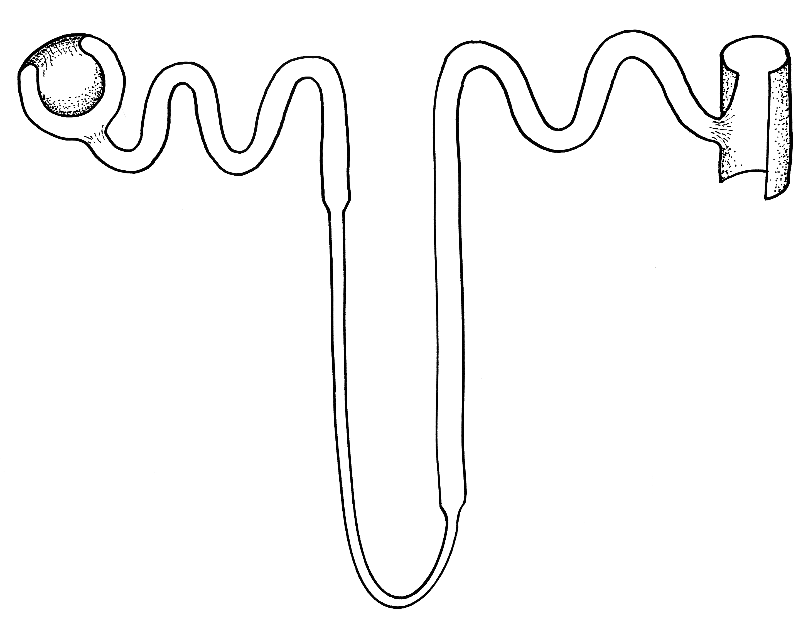
Low
Na+
concentration
In
filtrate
Aldosterone
stimulates sodium pumps
High
Na+
concentration
In
tissue
fluid
Na+
Na+
Na+
Na+

Slide 24
Negative feedback loop
Decreased blood volume
→ reduced blood pressure
Baroreceptors in Renal artery
Stimulus
Receptor
End-product is aldosterone from
adrenal cortex
Creates osmotic gradient
Control
centre
Feedback
Response
Effector
Sodium reabsorbed
Sodium pumps in DCT and loop of Henle

Slide 25
Reabsorption of water under the influence of antidiuretic hormone
Stimulus
Decreased blood volume
→ reduced blood pressure
→ increased osmotic pressure
Receptor
Osmoreceptors in hypothalamus → (activates thirst reflex)

Slide 26
Transmission
nerve signal to posterior pituitary gland
ADH released into bloodstream
Effector
DCT and collecting duct
Response
Increases permeability of above structures
water (approx 10%) reabsorbed

Slide 27
ADH increases
permeability of tubule
Relatively
dilute
filtrate
Water
leaves
the filtrate
by osmosis
Relatively
concentrated
tissue fluid

Slide 28
Negative feedback loop
Decreased blood volume
→ reduced blood pressure
→ increased osmotic pressure
Osmoreceptors in hypothalamus
Stimulus
Receptor
Osmotic pressure maintained or reduced
ADH from posterior pituitary gland
Control
centre
Feedback
Thirst reflex
Drink
Water
reabsorbed
Response
Effector
Increases permeability of DCT and collecting duct
DCT and collecting duct

Slide 29
Deamination
Definition - The stripping of nitrogen from amino
acid and nitrogen bases (RNA)
Deamination occurs in the liver
Amino acid → ammonia + organic compounds for respiration
Ammonia (very toxic) + CO₂ → urea (H₂NCONH₂)

Slide 30
Nitrogen Wastes
Nitrogen compound | Source | Amount | Relative Toxicity
Urea | Amino Acids | 21 g/day | Moderate
Creatinine | Muscle metabolism | 1.8 g/day | High
Uric acid | RNA | 480 mg/day | Weak

